Slide 1
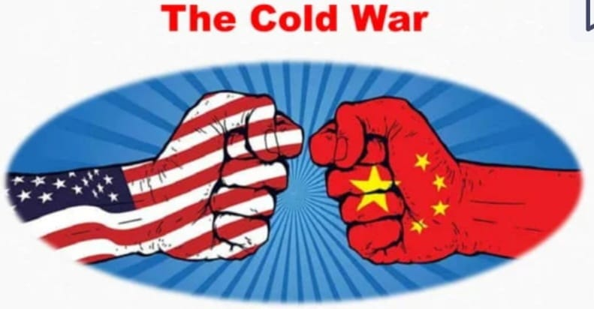
MEANING ,CAUSES AND IMPACT

Slide 2
Meaning and definitions of cold war
Meaning of cold war :-A cold war is a state of conflict between nations that does not involve direct military action but is pursued primarily through economic and political action, propaganda, acts of espionage or proxy wars waged by surrogates .This term is most commonly used to refer to the American – Soviet Cold War.
Definitions
According to John Dulles, “Cold war was a moral crusade for moral values for good against bad, right against wrong, religion against atheism.”
According to Flamming, “Cold war is a war that is fought not in the battlefield, but in the mind of men, one tries to control the minds of others.”

Slide 3
Characteristics of Cold War
Ideological War
Methods of Cold War were different than those of Traditional War
War without Weapons
War like situation
Use of Economic Aid
Faith in war preparedness for the maintenance of peace
Wordy war
Suspicion and mistrust
Cold war was not a real war
Diplomatic relations remained intact

Slide 4
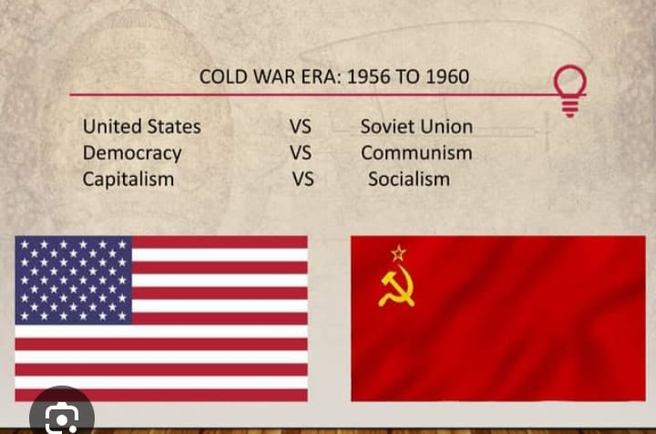

Slide 5
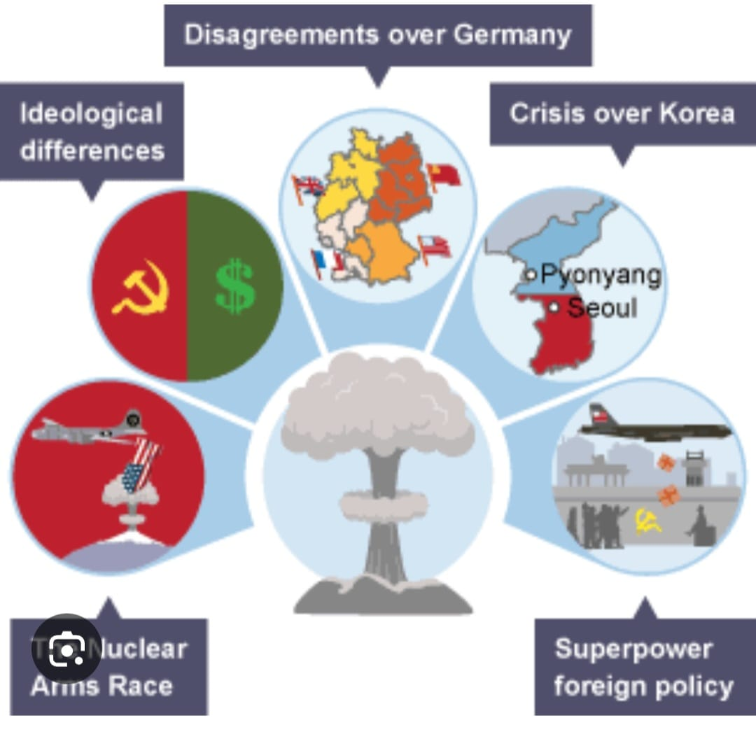
Causes of Cold War
Ideological differences
Nuclear arms race
Cold war conflicts
Disagreements over Germany
Nuclear weapons
Berlin Blockade
Cuban Missile Crisis
Space race
Tensions Between superpowers
The division of Korea
The fate of Eastern Europe
The Truman Doctrine
Vietnam
Spread of communism

Slide 6
Impact of Cold War on International Politics
Temporary arrangement turned permanent
Bi polar world
Atmosphere of bitterness
Arms race and militarization
Formation of military alliances
Rapid Decolonisation
Third world countries became the victim of cold war
Inernationalisation of regional conflicts
Birth of non- alignment movement
Set back to diplomacy
Use of propaganda as war fare

Slide 7
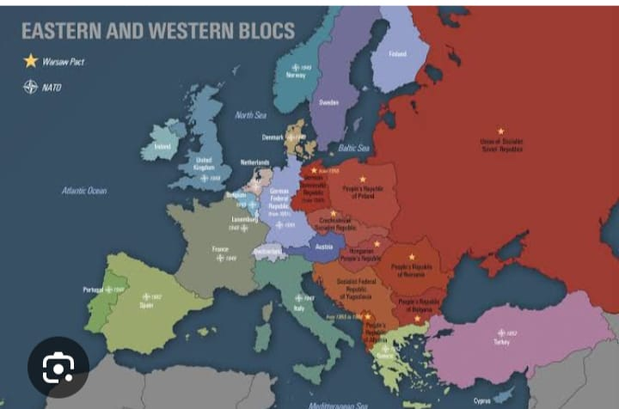
Cold war was able to avoid third world
war
Set back to collective security system
Set back to human welfare programmes
Set back to United Nations
Technological development
Faith in peaceful coexistence
Changes in Europe

Slide 8
THANK YOU

